Slide 1
What are Arrays?
In JS arrays are ordered sequences of elements
0 1 2 3 4
Element index
Array of 5 elements
… | … | … | … | …
Array element
Elements are numbered from 0 to length-1
Arrays hold key-value pairs
Key (0…length-1), value of any type (e.g. number / string / object)
Arrays have variable size – can be resized (unlike C# / Java / C++)

Slide 2
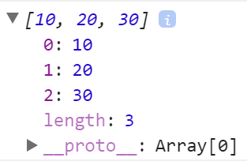
Arrays – Examples
let arr = [10, 20, 30];
console.log(arr); // [10, 20, 30]
console.log(arr.length); // 3
console.log(arr[0]); // 10
arr[0] = 5; // Elements can be modified
console.log(arr); // [5, 20, 30]
arr.push(500); // Elements are resizable
console.log(arr); // [5, 20, 30, 500]

Slide 3
Problem: Sum First and Last Array Elements
You are given array of strings holding numbers
Calculate and print the sum of the first and the last elements
20
30
40
60
5
10
15
2
4
function sumFirstAndLast(arr) {
return Number(arr[0]) + Number(arr[arr.length - 1]);
}
sumFirstAndLast(['20', '30', '40']) // 60
Check your solution here: https://judge.softuni.bg/Contests/311

Slide 4
Processing Arrays Elements
let capitals = ['Sofia', 'Washington', 'London', 'Paris'];
for (let capital of capitals)
console.log(capital);
for…of works like foreach
for...in goes through array indices
for (let i in capitals)
console.log(i + " " + capitals[i]);
for (let i = 0; i < capitals.length; i++)
console.log(capitals[i]);
Traditional for-loop

Slide 5
Processing Arrays Elements (2)
let capitals = ['Sofia', 'Washington', 'London', 'Paris'];
capitals.forEach(capital => console.log(capital));
capitals.forEach((capital, i) =>
console.log(i + ' -> ' + capital));
console.log(capitals.join(', '));
console.log(JSON.stringify(capitals));

Slide 6
Problem: Even Position Elements
Find the elements at even positions in array, space separated
function evenPositions(arr) {
let result = [];
for (let i in arr)
if (i % 2 == 0)
result.push(arr[i]);
return result.join(' ');
}
20
30
40
20 40
5
10
5
JS
JS
Check your solution here: https://judge.softuni.bg/Contests/311

Slide 7
Arrays of Different Types
// Array holding numbers
let numbers = [10, 20, 30, 40, 50];
// Array holding strings
let weekDays = ['Monday', 'Tuesday', 'Wednesday',
'Thursday', 'Friday', 'Saturday', 'Sunday'];
// Array holding mixed data
var mixedArr =
[20, new Date(), 'hello', {x:5, y:8}];

Slide 8
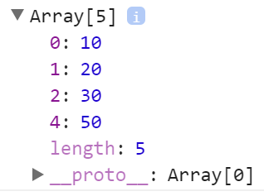
JS Arrays and Invalid Positions
let nums = [10, 20, 30];
nums[4] = 50; // Will resize the array
console.log(nums); // [10, 20, 30, ,50]
console.log(nums.length); // 5
console.log(nums[3]); // undefined
console.log(nums[-5]); // undefined
nums[-5] = -5; // Will not resize the array (invalid index)!
console.log([nums[-5], nums.length]); // [-5, 5]
console.log(nums[100]); // undefined
nums[100] = 100; // Will resize the array
console.log([nums[100], nums.length]); // [100, 101]

Slide 9


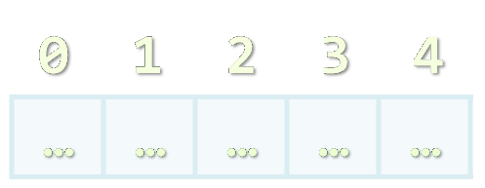

Array Operations
Push, Pop, Shift, Unshift, Slice, Join, …

Slide 10
Add / Remove Elements at Both Ends
let nums = [10, 20, 30];
console.log(nums.join('|')); // 10|20|30
nums.push(40);
console.log(nums.join('|')); // 10|20|30|40
let tail = nums.pop(); // tail = 40
console.log(nums.join('|')); // 10|20|30
nums.unshift(0);
console.log(nums.join('|')); // 0|10|20|30
let head = nums.shift(); // head = 0
console.log(nums.join('|')); // 10|20|30

Slide 11
Problem: Negative / Positive Numbers
You are given an array of numbers arr
Process them one by one and produce a new array result
Prepend each negative element at the front of result
Append each positive (or 0) element at the end of result
Print the result array, each element at separate line
7
-2
8
9
-2
7
8
9
3
-2
0
-1
-1
-2
3
0
-3
2
-1
0
-1
-3
2
0

Slide 12
Solution: Negative / Positive Numbers
function negativePositiveNumbers(arr) {
arr = arr.map(Number);
let result = [];
for (num of arr)
if (num < 0)
result.unshift(num); // Insert at the start
else
result.push(num); // Append at the end
console.log(result.join('\n'));
}
Check your solution here: https://judge.softuni.bg/Contests/311

Slide 13
Slicing Arrays
let nums = ['one', 'two', 'three', 'four'];
console.log(nums.join('|')); // one|two|three|four
let firstNums = nums.slice(0, 2); // start, end+1
console.log(firstNums.join('|')); // one|two
let lastNums = nums.slice(2, 4); // start, end+1
console.log(lastNums.join('|')); // three|four
let midNums = nums.slice(1, 3); // start, end+1
console.log(midNums.join('|')); // two|three

Slide 14
Splice: Cut and Insert Array Elements
let nums = [5, 10, 15, 20, 25, 30];
console.log(nums.join('|')); // 5|10|15|20|25|30
let mid = nums.splice(2, 3); // start, delete-count
console.log(mid.join('|')); // 15|20|25
console.log(nums.join('|')); // 5|10|30
nums = [5, 10, 15, 20, 25, 30];
nums.splice(3, 2, "twenty", "twenty-five");
console.log(nums.join('|'));
// 5|10|15|twenty|twenty-five|30

Slide 15
Problem: First and Last K Numbers
You are given an array of numbers
The first element holds an integer k
Print the first k and the last k from the other elements in the array (space separated)
2
7
8
9
7 8
8 9
3
6
7
8
9
function firstLastKElements(arr) {
let k = Number(arr.shift());
console.log(arr.slice(0, k).join(' '));
console.log(arr.slice(arr.length-k,
arr.length).join(' '));
}
6 7 8
7 8 9
1
5
5
5
Check your solution here: https://judge.softuni.bg/Contests/311

Slide 16
Problem: Sum Last K Numbers Sequence
Take two integers n and k
Generate and print the following sequence:
The first element is: 1
All other elements = sum of the previous k elements
Example: n = 9, k = 5
120 = 4 + 8 + 16 + 31 + 61
6
3
Sequence:
1 1 2 4 7 13
8
2
Sequence:
1 1 2 3 5 8 13 21
9
5
Sequence:
1 1 2 4 8 16 31 61 120
+
1 1 2 4 8 16 31 61 120
Check your solution here: https://judge.softuni.bg/Contests/311

Slide 17
Solution: Sum Last K Numbers Sequence
function sumLastKNumbersSequence([n, k]) {
let seq = [1];
for (let current = 1; current < n; current++) {
let start = Math.max(0, current - k);
let end = current - 1;
let sum = // TODO: sum the values of seq[start … end]
seq[current] = sum;
}
console.log(seq.join(' '));
}
Check your solution here: https://judge.softuni.bg/Contests/311

Slide 18
Filtering and Transforming Elements
let nums = ['one', 'two', 'three', 'four'];
console.log(nums.join('|')); // one|two|three|four
let filteredNums =
nums.filter(x => x.startsWith('t'));
console.log(filteredNums.join('|')); // two|three
let lengths = nums.map(x => x.length);
console.log(lengths.join('|')); // 3|3|5|4
let lengths = nums.map(x => [x.length, x[0]]);
console.log(lengths.join('|')); // 3,o|3,t|5,t|4,f

Slide 19
Problem: Process Odd Numbers
You are given an array of numbers
Print the odd numbers, doubled and reversed
10
15
20
25
50 30
function firstLastKElements(arr) {
let result = arr
.filter((num, i) => i % 2 == 1)
.map(x => 2*x)
.reverse();
return result.join(' ');
}
3
0
10
4
7
3
6 8 0
Check your solution here: https://judge.softuni.bg/Contests/311

Slide 20

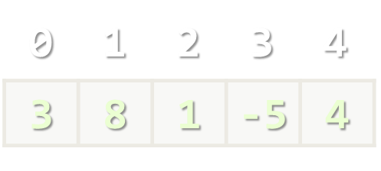
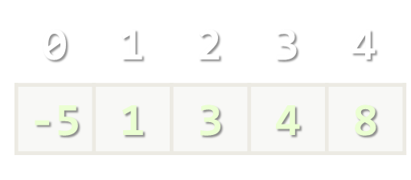
Sorting Arrays
Arranging Elements in Increasing Order

Slide 21
Sorting Arrays
let nums = [20, 40, 10, 30, 100, 5];
console.log(nums.join('|')); // 20|40|10|30|100|5
nums.sort(); // Works incorrectly on arrays of numbers !!!
console.log(nums.join('|')); // 10|100|20|30|40|5
nums.sort((a, b) => a-b); // Compare elements as numbers
console.log(nums.join('|')); // 5|10|20|30|40|100

Slide 22
Problem: Smallest 2 Numbers
You are given an array of numbers
Print the smallest two numbers
30
15
50
5
5 15
function smallestTwoNumbers(arr) {
arr.sort((a, b) => a-b);
let result = arr.slice(0, 2);
return result.join(' ');
}
3
0
10
4
7
3
0 3
Check your solution here: https://judge.softuni.bg/Contests/311

Slide 23
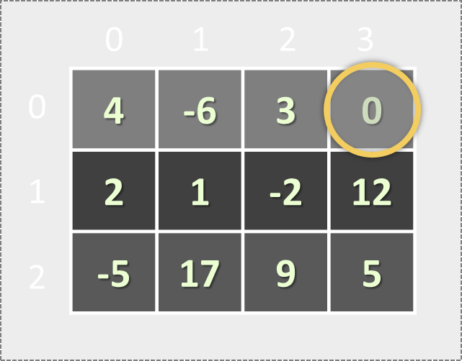
Matrices (Tables)
Arrays Holding Arrays

Slide 24
Matrices in JS
A matrix is a table of values
Represented as nested arrays in JavaScript
0 1 2 3
Matrix of 4 rows
0
1
2
3
4 | -6 | 3 | 0
var matrix = [
[4, -6, 3, 0],
[2, 1, -2],
[-5, 17],
[7, 3, -9, 12]
];
2 | 1 | -2
Element matrix[2][0] at row 2, column 0
-5 | 17
7 | 3 | -9 | 12

Slide 25
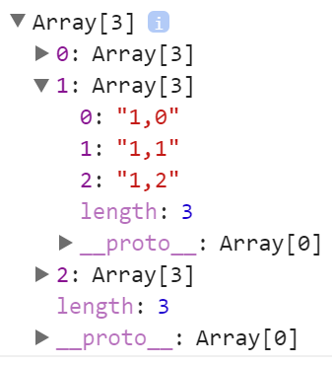
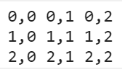
Matrix – Example
Defining a matrix (array of arrays)
var matrix = [
['0,0', '0,1', '0,2'],
['1,0', '1,1', '1,2'],
['2,0', '2,1', '2,2']
];
Join the cells in each row by ' ', then join the rows by '\n')
Printing a matrix
console.log(
matrix.map(row => row.join(' '))
.join('\n'));

Slide 26
Problem: Biggest Element in Matrix
A matrix of numbers comes as array of strings
Each string holds numbers (space separated)
Write a JS function to find the biggest number
3 5 17 12 91 5
-1 7 4 33 6 22
1 8 99 3 10 43
3 5 7 12
-1 4 33 2
8 3 0 4
20 50 10
8 33 145
99
33
145

Slide 27
Solution: Biggest Element in Matrix
function biggestElement(matrixRows) {
let matrix = matrixRows.map(
row => row.split(' ').map(Number));
let biggestNum = Number.NEGATIVE_INFINITY;
matrix.forEach(
r => r.forEach(
c => biggestNum = Math.max(biggestNum, c)));
return biggestNum;
}
20 50 10
8 33 145
biggestElement(['20 50 10', '8 33 145']); // 145
Check your solution here: https://judge.softuni.bg/Contests/311

Slide 28
Problem: Diagonal Sums
A square matrix of numbers comes as array of strings
Each string holds numbers (space separated)
Find sum at the main and at the secondary diagonals
20 40
10 60
3 5 17
-1 7 14
1 -8 89
80 50
99 25

Slide 29
Solution: Diagonal Sums
function diagonalSums(matrixRows) {
let matrix = matrixRows.map(
row => row.split(' ').map(Number));
let mainSum = 0, secondarySum = 0;
for (let row = 0; row < matrix.length; row++) {
mainSum += matrix[row][row];
secondarySum += matrix[row][matrix.length-row-1];
}
console.log(mainSum + ' ' + secondarySum);
}
3 5 17
-1 7 14
1 -8 89
diagonalSums(['20 40', '10 60']); // 80 50
Check your solution here: https://judge.softuni.bg/Contests/311

Slide 30
Problem: Equal Neighbors
You are given a matrix of elements
Find the number of equal neighbors
2 3 4 7 0
4 0 5 3 4
2 3 5 4 2
9 8 7 5 4
2 2 5 7 4
4 0 5 3 4
2 5 5 4 2
test yes yo ho
well done yo 6
not done yet 5
5
2
1

Slide 31
Problem: Equal Neighbors
function equalNeighborsCount(matrixRows) {
let matrix = matrixRows.map(
row => row.split(' ').map(Number));
let neighbors = 0;
for (let row = 0; row < matrix.length-1; row++)
for (let col = 0; col < matrix[row].length; col++)
if (matrix[row][col] == matrix[row + 1][col])
neighbors++;
// TODO: check also the horizontal neighbors
return neighbors;
}
2 2 5 7 4
4 0 5 3 4
2 5 5 4 2
Check your solution here: https://judge.softuni.bg/Contests/311

Slide 32


Summary
Arrays in JS hold sequence of elements
Elements are accessed by index
Behave like lists (add / delete elements)
Matrices are arrays holding arrays
let nums = [10, 20, 30, 40];
nums[2] = 100;
nums.push('new element');
let matrix = [[10, 20], [30, 40]];

